Slide 1

VE496 Advanced Technical Communication
Week 7:
Creating Technical Charts and Diagrams
Nathaniel T. Murray 莫子禅
Summer 2020

Slide 2
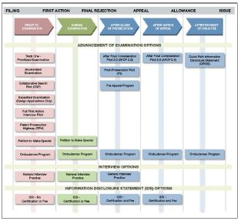
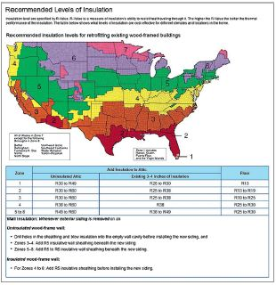
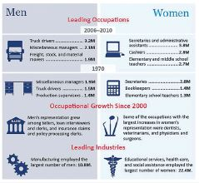
Organizing Information Visually
Graphic Type | Organizing Information | Example Signal Words
Timeline | Order of events that occurred or that should occur | the first step the next part the third phase
Spatial | Describe physical scenes, objects, or locations | directly above to the left of centered
Comparison and contrast | Establish guidelines by which things are compared, and stick to all those criteria when making comparison | similarly in contrast by comparison
Source: Markel & Selber (2018)

Slide 3
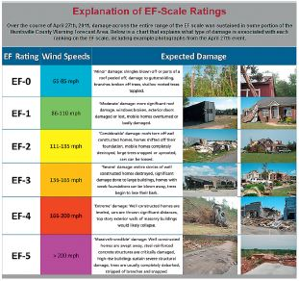
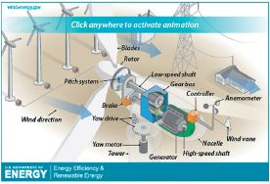



Organizing Information Visually
Graphic Type | Organizing Information | Example Signal Words
Partition or classification | Establish categories in logical sequence (i.e. parts of a machine, degrees of severity) | first level, second level control system, auxiliary system
Table | Show large amounts of numerical data with multiple variables | 6% higher when increase of 15 points from
Bar graph | Show relative values of two or more items across some variables | greater than less than
Line graph | Show how value or quantity of items change over time | 20% decrease between sharp spike steady decline
Source: Markel & Selber (2018)

Slide 4




Organizing Information Visually
Graphic Type | Organizing Information | Example Signal Words
Pie chart | Show relative size of parts of whole | larger than smaller than
Diagram | Illustrate relationships between items or properties of items | connection between link to
Organizational chart | Show hierarchical relationships or lines of authority | over, under subordinate to
Checklist | Show necessary equipment or materials, and required steps | using the apply the
Source: Markel & Selber (2018)

Slide 5




Organizing Information Visually
Graphic Type | Organizing Information | Example Signal Words
Flowchart | Delineate stages in a process or procedure, with decision trees | first, next if … then …
Photograph | Show external surface of objects | texture appearance
Screenshot | Show what appears on a computer | shown, displayed information contained in
Source: Markel & Selber (2018)

Slide 6
Principles of Designing Graphics and Visuals
Content
Intended to be integrated with text
Contains “manageable” amount of data
Accurately and ethically represents data
Units of measurement logical for the data you wish to represent
Format
Colors: use of color patterns to direct attention or compare/contrast
Labels and units of measurement visible but unobtrusive
Spacing and positioning: simple and uncluttered

Slide 7
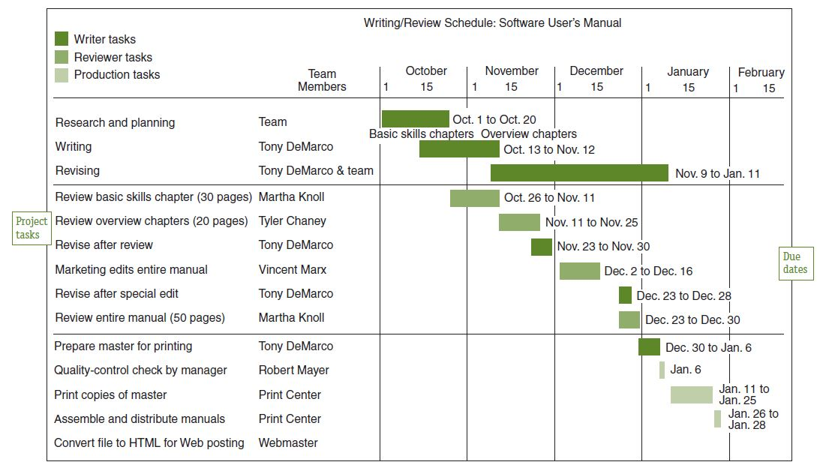
Gantt Chart
Source: Alred et al., 2015, p. 242

Slide 8
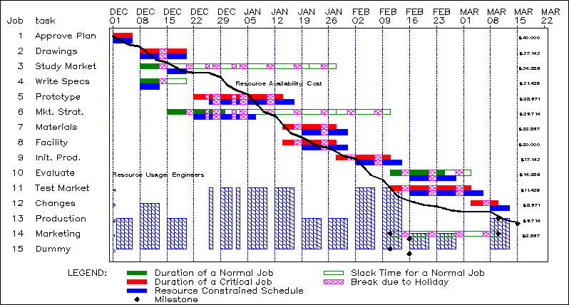
Gantt Chart
Source: https://support.sas.com/rnd/app/or/procedures/gantt.html

Slide 9
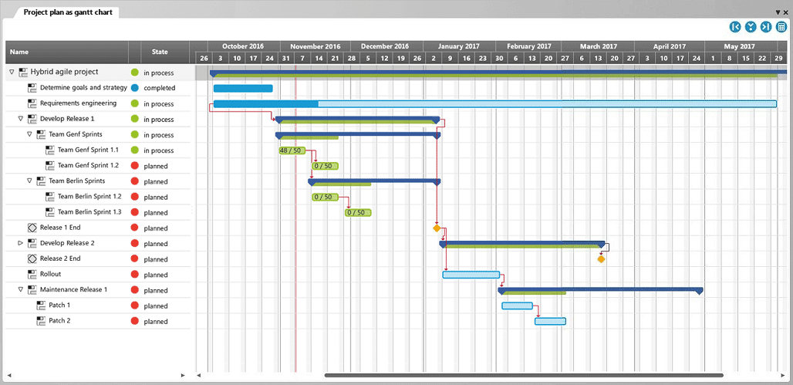
Gantt Chart
Source: https://www.microtool.de/en/knowledge-base/what-is-a-gantt-chart/

Slide 10
Gantt Chart: Elements
Time (x-axis): days, weeks, months, or a subdivided combination
Tasks (y-axis): comprehensive list of tasks that must be completed
Task bars: each bar representing an individual task
Milestones: design reviews, decision points, completion deadlines, etc.
Slack time: the window of time within which a delay in a given task would not seriously affect progress on the project
“Today” line: put a vertical line on the current date, to assess the level of progress and completion of the individual tasks
Critical path: the longest path a project can take without significantly delaying or endangering the completion

Slide 11
Gantt Chart: Guidelines
All date-related cells equally spaced in width
Units of time at the top, not the bottom as in other diagram types
Light gray shading of all cell borders, but no borders in top left corner
Task bars shaded different colors for project phase or delegation to different teams or team members
Contrast between light shading of task/date-related cells, and dark shading of task bars
Key/legend explaining the meaning of each icon and task bar shading
Different icon for each type of event, e.g. design review, decision point
Task bars vertically centered in the rows for polished appearance
No verbal explanations in the chart itself, but rather in the key/legend, for cleaner and more readable format
Tab or ‘Insert Rows’ to add more rows as needed

Slide 12

Project Title
 | June |  |  |  | July |  |  |  | August
 | Week 1 | Week 2 | Week 3 | Week 4 | Week 1 | Week 2 | Week 3 | Week 4 | Week 1 | Week 2 | Week 3 | Week 4
Task 1
Task 2
Task 3
Task 4
Task 5
Key
Team A
Design review

Slide 13
Excel Formatting Principles
Tables | Charts/Graphs
Title | Title
Merge cells and center | Positioning
Font | Key/Legend
Size and style | Positioning
Bold, italics, underline | Font and colors
Cell | Content
Borders | Data labels
Colors and format | Units of measurement on x- and y-axes
Width and alignment | Color scheme: contrast or complement

Slide 14
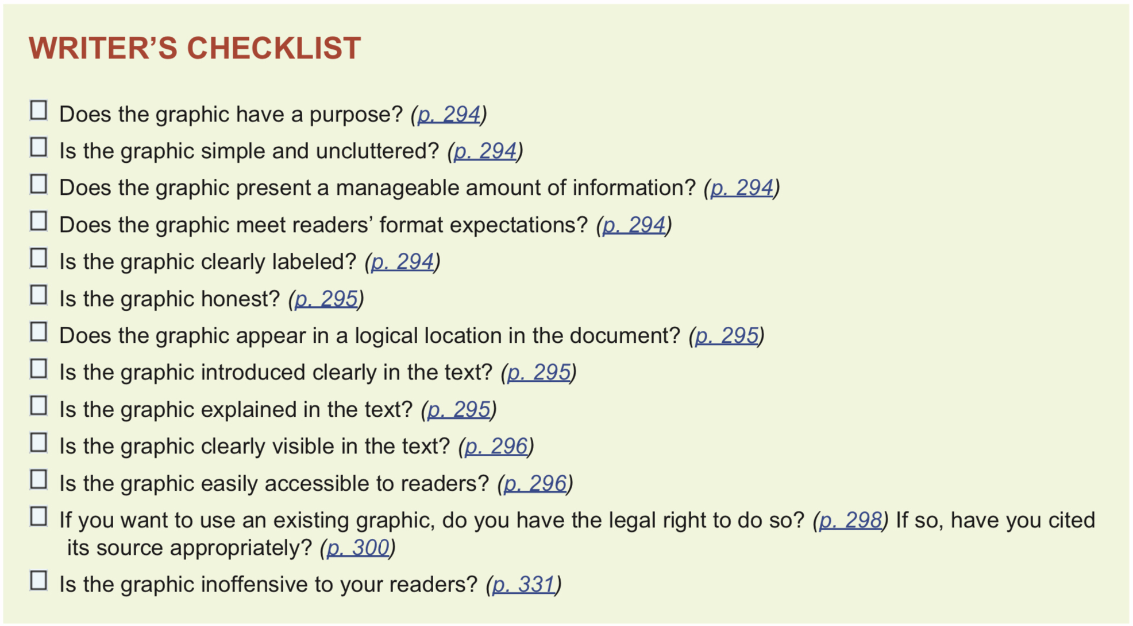
Source: Markel & Selber (2018)

